Slide 1
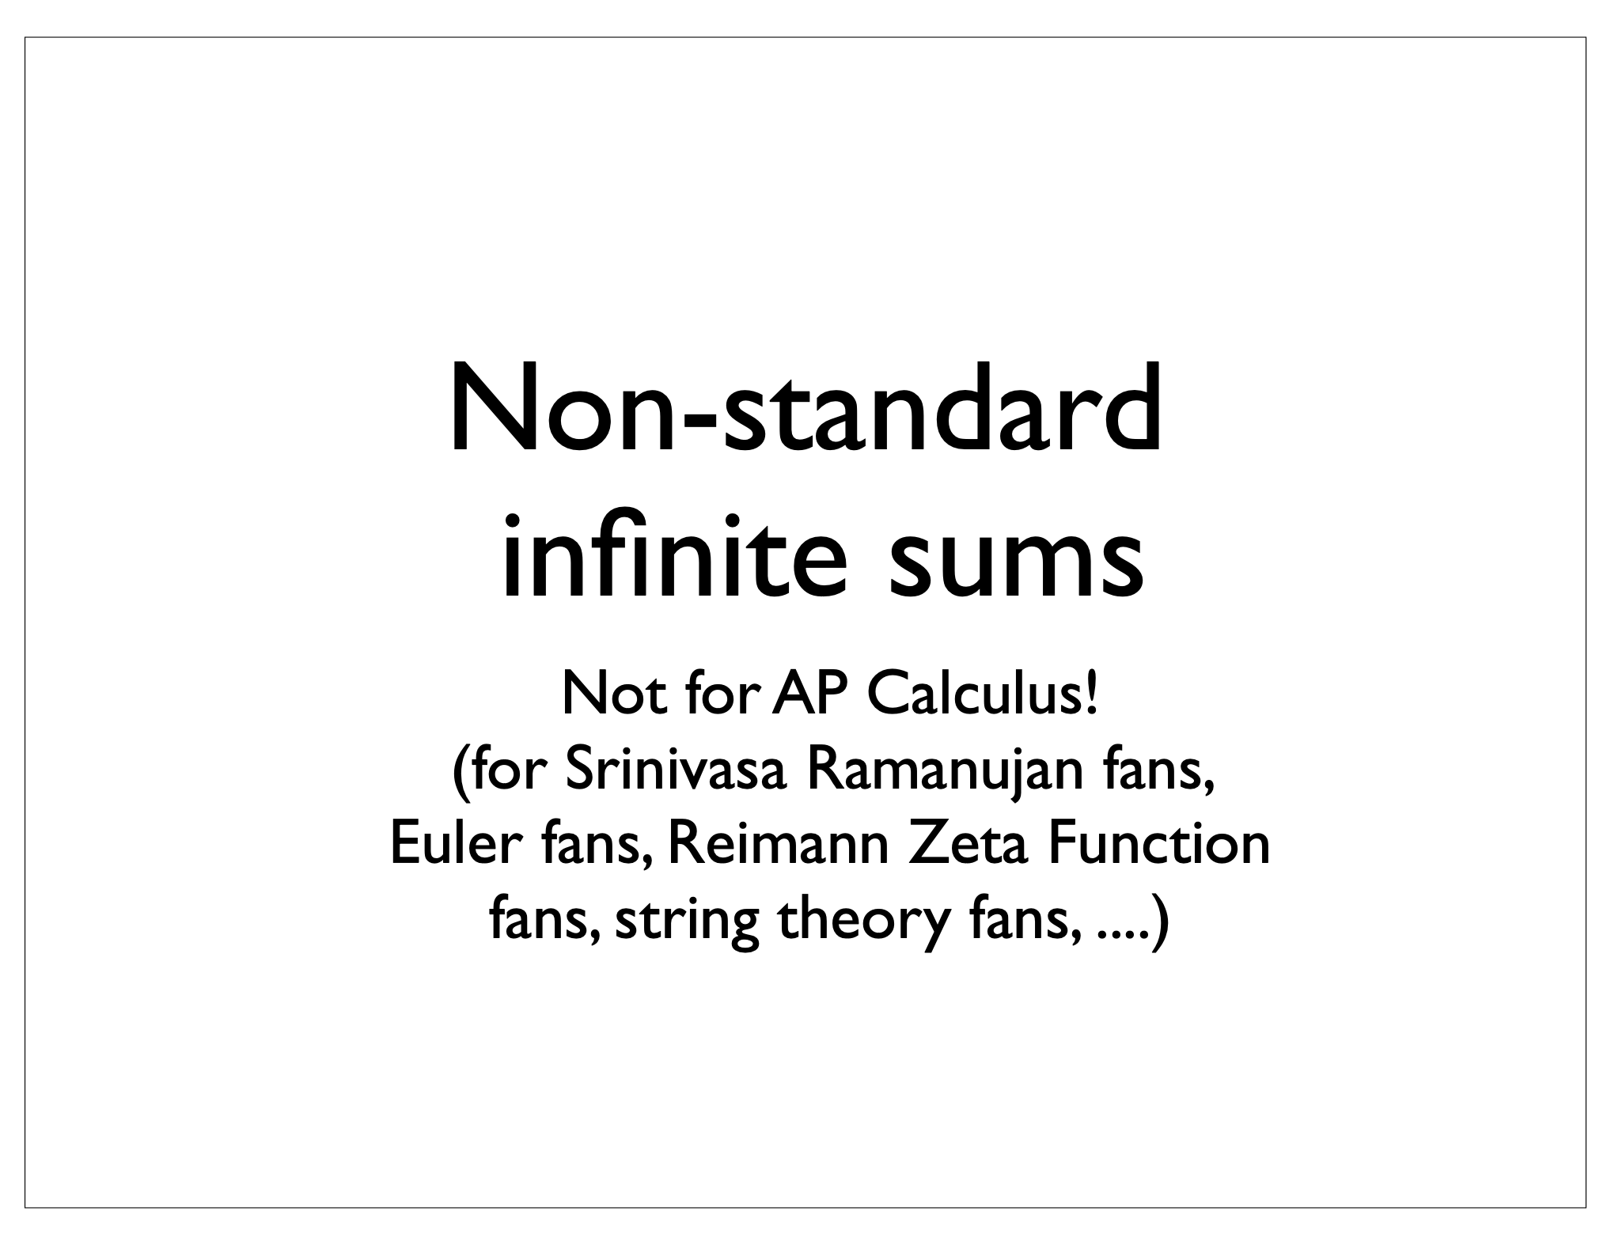

Slide 2
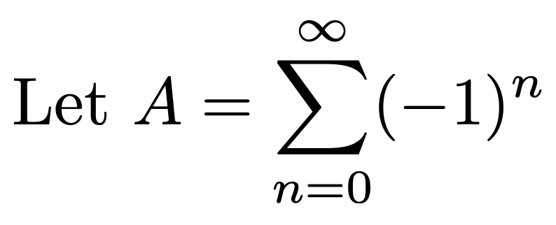
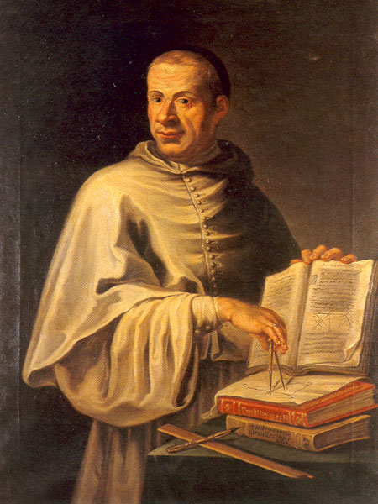



Dom Luigi Guido Grandi, OSBCam 1671-1742

Slide 3
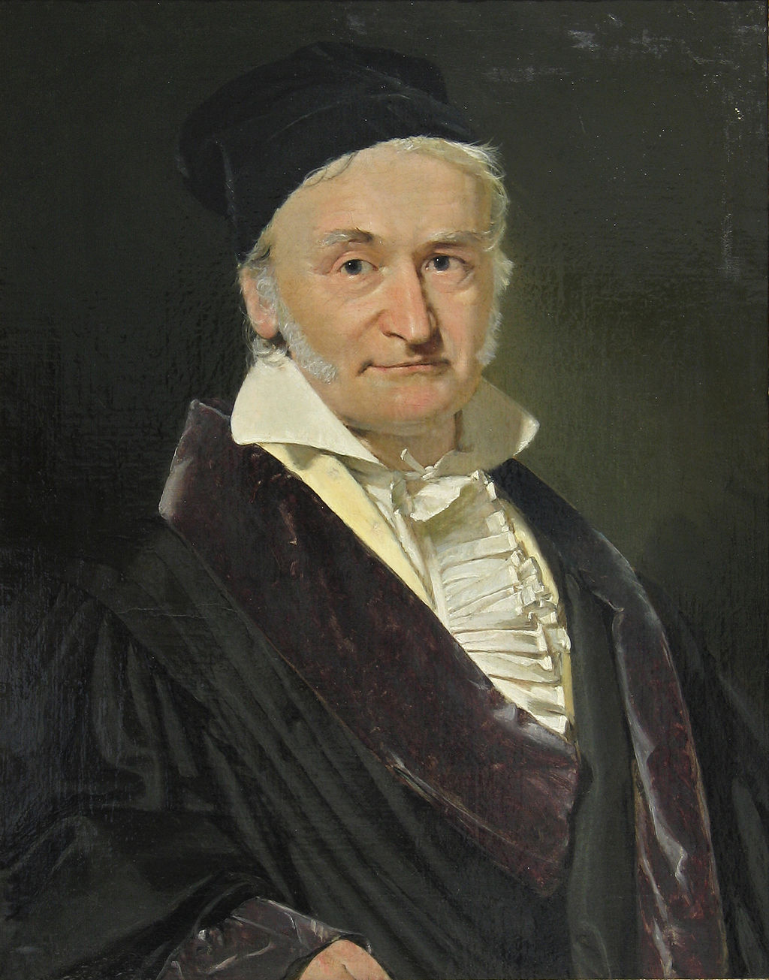

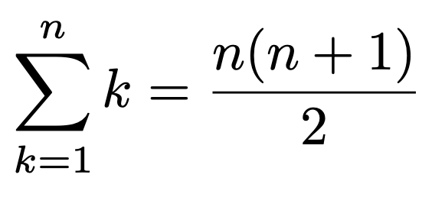


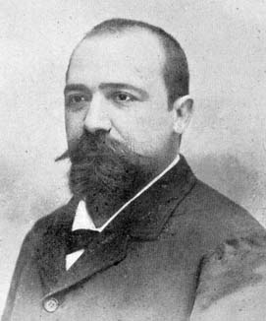

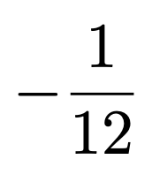
Adding the counting numbers
Karl Friedrik Gauß (1777-1855)
Ernesto Cesàro (1859-1906)
Cesàro Summation

Slide 4
